Slide 1



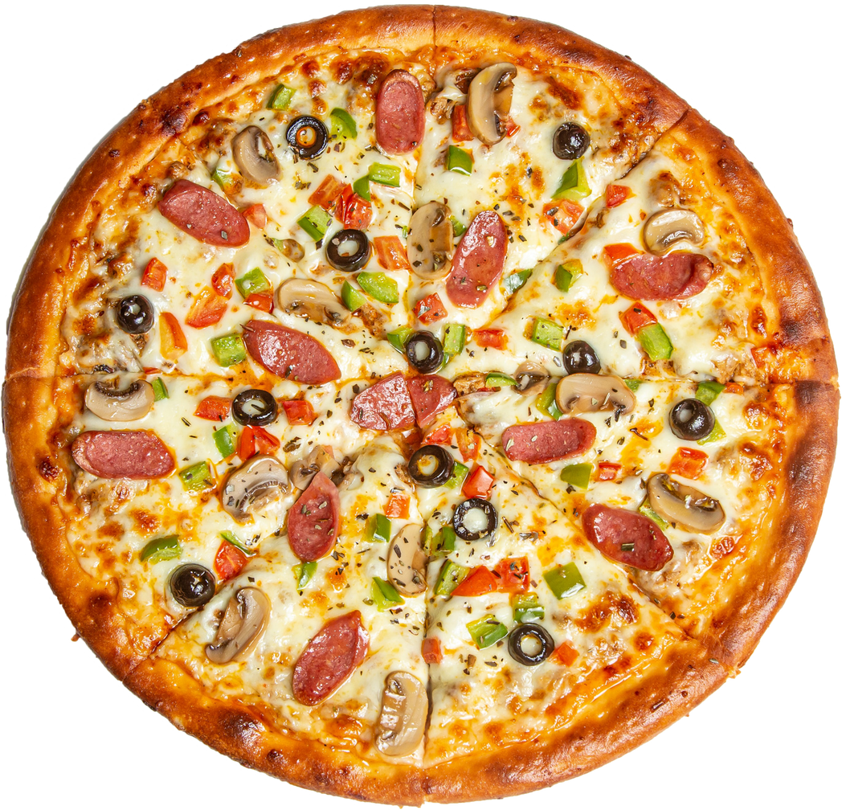


Pizza Time
PIZZA SALES PROJECT
Cashback
UP TO
40%

Slide 2
"HELLO, MY NAME IS MUHAMMAD AHMAD ALI. IN THIS PROJECT, I UTILIZED SQL QUERIES TO ANALYZE PIZZA SALES DATA. THE GOAL WAS TO ANSWER BUSINESS-RELATED QUESTIONS SUCH AS IDENTIFYING BEST-SELLING PIZZAS, DETERMINING PEAK SALES PERIODS, AND CALCULATING MONTHLY REVENUE. I APPLIED SQL TECHNIQUES INCLUDING JOINS, GROUP BY, AND AGGREGATE FUNCTIONS. THIS PROJECT HELPED ME GAIN HANDS-ON EXPERIENCE WITH DATA ANALYSIS AND PROVIDED VALUABLE INSIGHTS INTO SALES TRENDS. IT ALSO STRENGTHENED MY UNDERSTANDING OF SQL AND HOW TO USE IT EFFECTIVELY IN REAL-WORLD SCENARIOS."

Slide 3
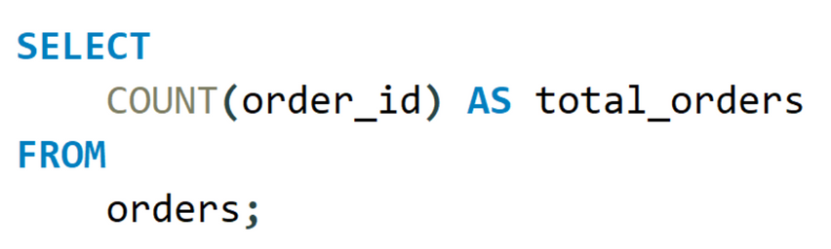
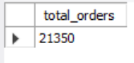
# RETRIEVE THE TOTAL NUMBER OF ORDERS PLACED.

Slide 4
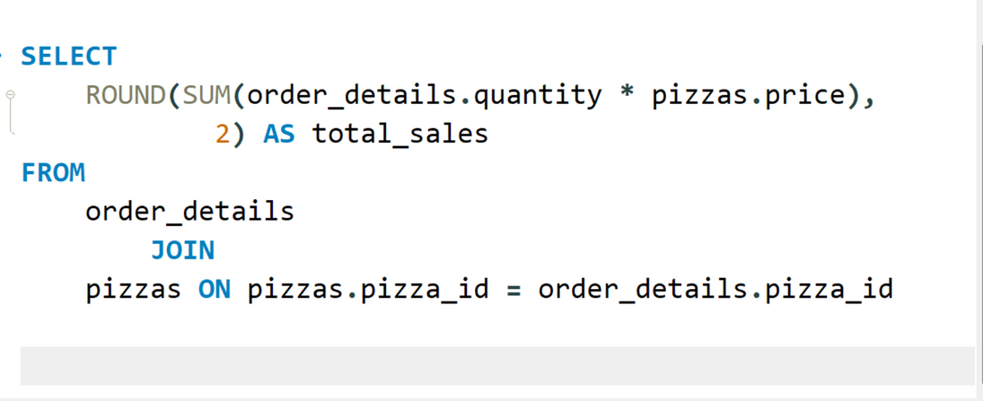
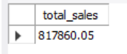
CALCULATE THE TOTAL REVENUE GENERATED FROM PIZZA SALES.

Slide 5
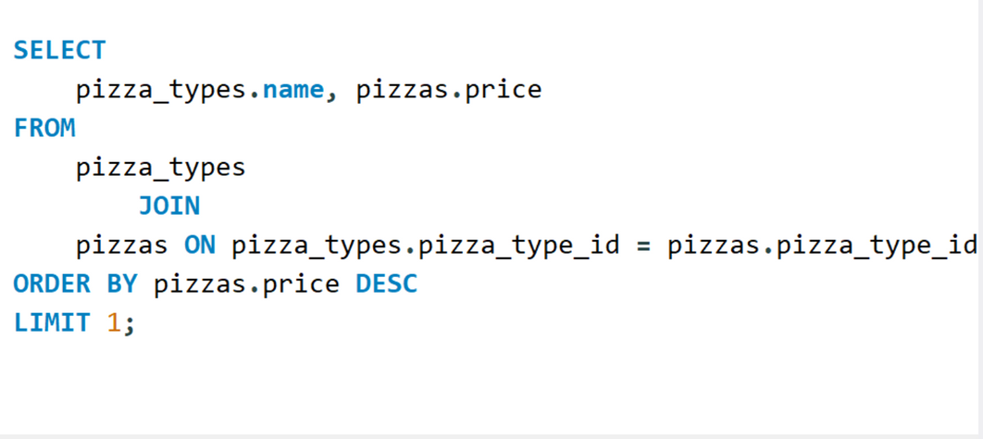
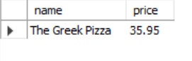
# IDENTIFY THE HIGHEST-PRICED PIZZA.

Slide 6
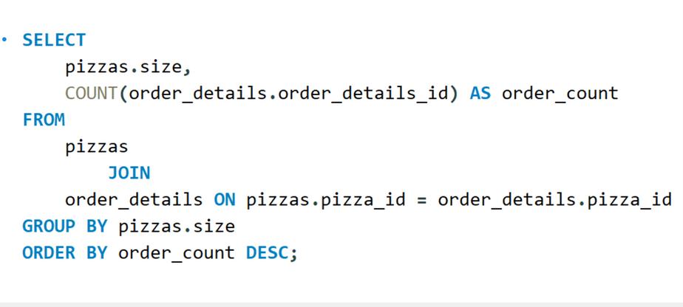
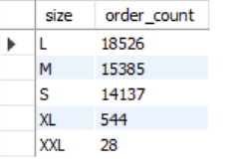
# IDENTIFY THE MOST COMMON PIZZA SIZE ORDERD.

Slide 7
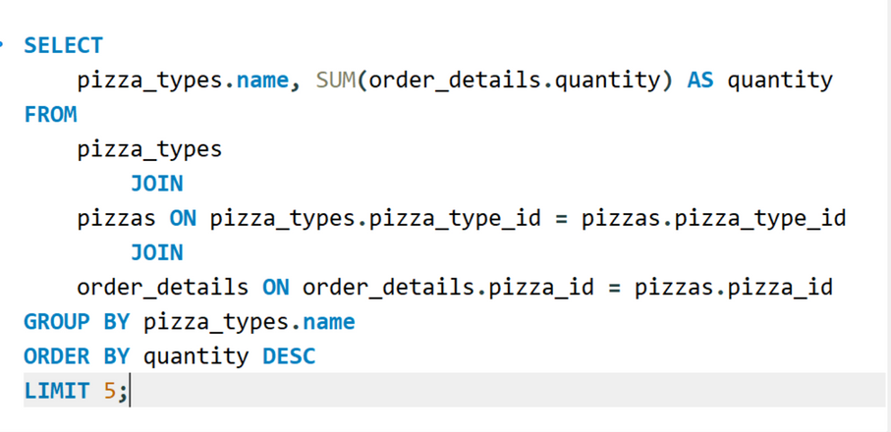
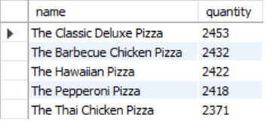
# LIST OF THE TOP 5 MOST ORDERED PIZZA TYPES ALONG WITH THEIR QUANTITIES.

Slide 8
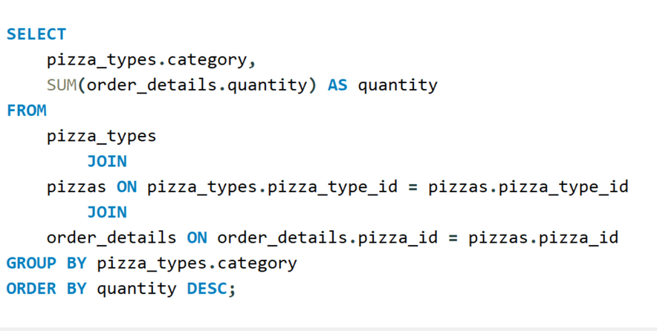
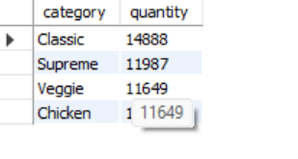
# JOIN THE NECESSARY TABLE TO FIND THE TOTAL QUANTITY OF EACH PIZZA CATEGORY ORDERED.

Slide 9
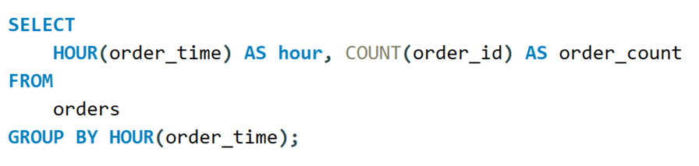
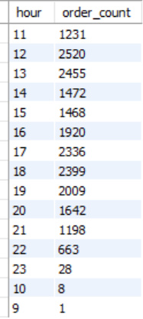
# DETERMINE THE DISTRIBUTION OF ORDERS BY HOUR OF THE DAY.

Slide 10
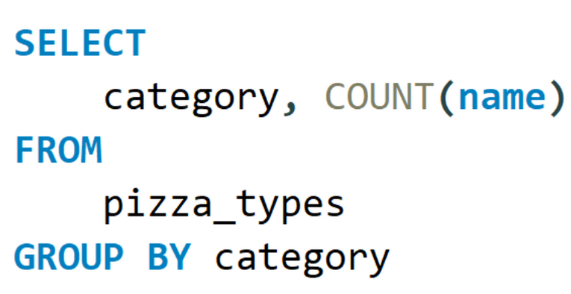
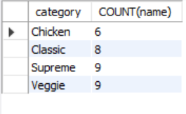
# JOIN RELEVANT TABLES TO FIND THE CATEGORY-WISE DISTRIBUTION OF PIZZAS.

Slide 11
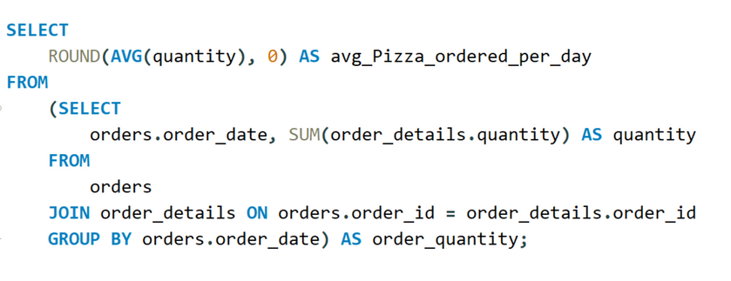
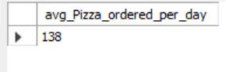
GROUP THE ORDERS BY DATE AND CALCULATE THE AVERAGE NUMBER OF PIZZAS ORDERED PER DAY

Slide 12
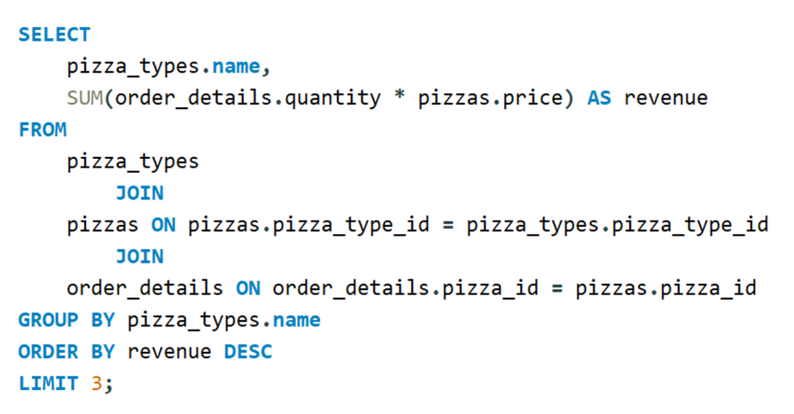
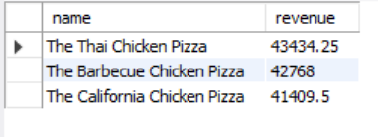
DETERMINE THE TOP 3 MOST ORDERED PIZZA TYPES BASED ON REVENUE.

Slide 13
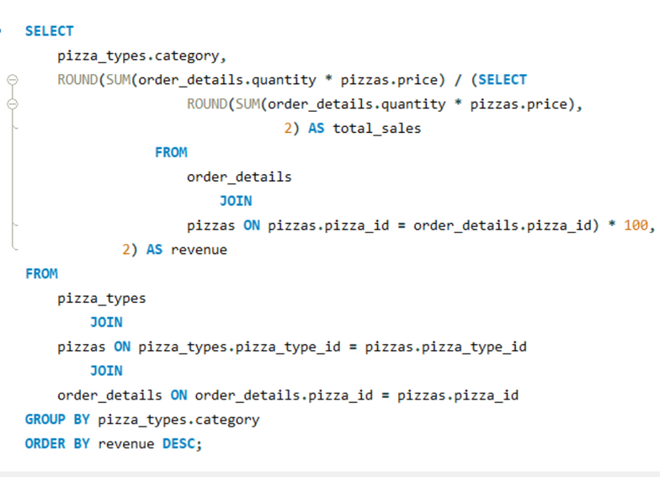
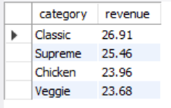
# CALCULATE THE PERCENTAGE CONTRIBUTION OF EACH PIZZA TYPE TO TOTAL REVENUE.

Slide 14
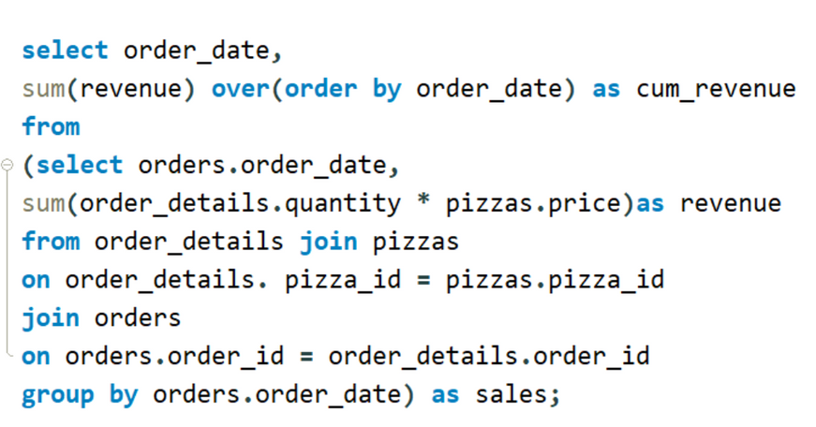
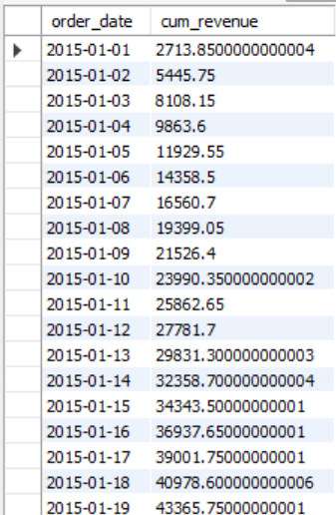
# ANALYZE THE CUMULATIVE REVENUE GENERATED OVER TIME.

Slide 15
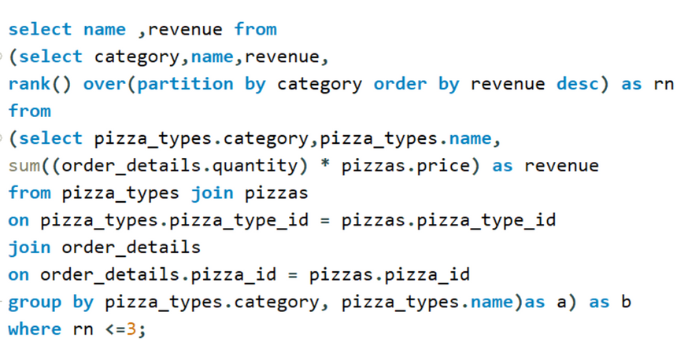
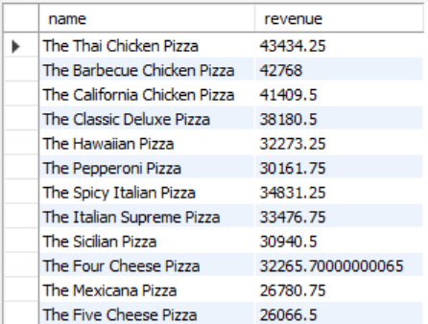
DETERMINE THE TOP 3 MOST ORDERED PIZZA TYPES BASED ON REVENUE FOR EACH PIZZA CATEGORY.

